Slide 1
INDIAN INSTITUTE OF INFORMATION TECHNOLOGY NAGPUR
Institute of National Importance by an Act of Parliament
TRAINING & PLACEMENT BROCHURE

Slide 2
About Us
INDIAN INSTITUTE OF INFORMATION TECHNOLOGY NAGPUR (IIITN) is one of the twenty Indian Institutes
of Information Technology in India. It is set up with the objective
of making available facilities for higher education, research
and training in various fields of Information Technology. Established in the year 2016 by the Ministry of Human Resources Development (MHRD), Government of India, and TCS as industry partner to address the challenges faced by the Indian IT industry and growth of the domestic IT market.
It is declared as an Institute of National Importance by an Act of Parliament – “The Indian Institutes of Information Technology (Public-Private Partnership) 2017”. The Institute is committed to get itself recognized as a leader in Information Technology related Science and Engineering. It wishes to establish a firm foundation for education and research with a high-quality faculty base and having a vision to be the fountainhead of new ideas and innovations in Science and Technology. IIIT Nagpur strives to create an ambience in which new ideas, research and scholarship flourish and from which the leaders and innovators and IT-entrepreneurs of tomorrow emerge.
Our Vision
“To advance new knowledge and innovation in Information Technology and allied fields to power the nation to the forefront in the global context”
Our Mission
“The mission of IIITN is to develop competent and capable youth imbued with the spirit of innovation and entrepreneurship with the social and environmental orientation to meet the knowledge needs of the country and provide global leadership in Information Technology and allied fields.”
Our Partners

Slide 3
Administration
Director - Dr. O.G. Kakde
He has worked as Director – VJTI Mumbai, Dean (Research and Consultancy) and Head CSE and Electronics Department at VNIT Nagpur. He has got extensive experience of 30 years in Academics, Research and Guidance, and General Administration. He is a graduate from VNIT and post graduate from IIT-Bombay. He holds Ph.D in Computer Science.
From Director’s Desk:
“Within a short span of less than three years, IIIT Nagpur has started attracting talented students, who want to work on challenging problems in the field of Information Technology. IIIT Nagpur has also started attracting a good number of Industry professionals to pursue research in cutting edge technologies. We highly value our partnership with prospective recruiters and industry partners and
are committed to making your recruiting experience productive and positive. I hereby invite the employers to get the best workforce
you need from IIITN.”
I/c Dean - Dr. Ashwin Kothari dean@iiitn.ac.in/agkothari72@rediffmail.com +91 98901 64705 | I/c Registrar – Shri Kailas N. Dakhale registrar@iiitn.ac.in +91 80879 83449
Head , Dept of ECE – Dr. Ankit Bhurane ankit.bhurane@gmail.com +91 99604 02260 | Head, Dept of CSE – Dr. Pooja Jain iiitngpcse@gmail.com +91 93188 28066
Sr. Office Associate T&P – Mr. Harshad Panse tnp@iiitn.ac.in , iiitntnp@gmail.com +91 92255 31185 | Head, Dept of Basic Sciences and Engineering – Dr. Aatish Daryapurkar asdaryapurkar@gmail.com, +91 98672 45331

Slide 4
Faculty
Our faculty comprises of young and dynamic members who have completed their doctoral degrees from reputed Indian institutes and foreign universities. The teaching force also includes subject experts from Industry and also from prestigious VNIT Nagpur, which is our Mentor Institute.
Research Areas
Our research oriented faculties lead from front and motivate students in research areas. They have published numerous research papers in reputed national and international journals. Following are the areas of research at IIIT Nagpur:
Courses offered
Admissions to IIITN are only through Joint Seat Allocation Authority (JoSAA), based on JEE(Mains) scores. Engineering aspirants from all over India opt for IIIT Nagpur. Getting into IIITN has become tougher over the years, which ensures academically strong students are admitted to IIITN.
Courses offered and intake
B.TECH (4 Years)
Computer Science and Engineering = 144 Seats
Electronics and Communication Engineering = 108 Seats
Ph.D programmes in CSE and ECE = 20 seats
M.Tech programmes will be launched soon.
Our first batch of PhD candidates is undergoing research work at IIITN under various supervisors in areas of Machine Learning, Image Processing, Communications, etc.
Our Ph.D programme also facilitates people from Industry to pursue research interests under Industry-Academia Collaboration.
Signal, Image and Video Processing Biomedical Signal Processing Antennas Design Wireless Communication Wireless Sensor Network Civionics | Deep Learning Machine Learning Parallel Computing High Performance Computing Data Mining Internet of Things Pattern recognition Automotive Electronics Data Analytics

Slide 5
Industry Academia Collaboration
Tie up with Tata Consultancy Services as Industry Partner.
MoU with ESIEE (École Supérieure d'Ingénieurs en Électrotechnique et Électronique) Paris- Graduate School of Engineering, based in France for exchange programmes.
Lecture series delivered by Tech experts from industry.
IT Workshops on Data Structures, Python, HTML,Matlab, Robotics, Machine Learning etc.are conducted regularly by subject experts from IT industry.
USPs of Curriculum
Core subjects incorporated right from the first semester.
The subjects and their contents are dynamic and revised time to time in consultation with technology experts.
Choice Based Credit System gives an option to students to choose subjects of their choice.
Credit based mandatory industry internship for six months.
Option to pursue credit based Online Certification Courses from Coursera, Udemy, Google Certifications, etc.
Internships and Placements
Efforts are made at IIITN to make students employable through various initiatives viz. Industry Internship, Workshops, Guest Lectures, Trainings, Events, etc. Students at IIITN participate regularly at inter-college competition like Hackathon, Robotics, Paper presentation, etc.
Rationale behind Industry Internship Programme
As a part of the curriculum, students at IIITN are required to pursue a semester-long full-time industry internship in prominent companies. This helps them in getting the much-required exposure to the real-life corporate and technical platforms. Throughout the internship, students’ performance is monitored and evaluated.
Trainings
Campus Recruitment Training is a crucial aspect of the placement preparations. Students at IIITN are critically trained on aspects like Aptitude, Group Discussions, and Interview. Students are encouraged to take up entrepreneurship through interaction with founders of startups.

Slide 6
Final year B.Tech students got offers from these Organizations for Semester Internship (6 Months)
Highest Stipend Rs.40,000/-
*100% internship placements in the year 2019*
Average Stipend Rs.14,000/-

Slide 7
Second and Third year B.Tech students selected at these Organizations for Summer Internship (2months)

Slide 8
Students’ Achievements
Parth Wazurkar from CSE department participated in Google Summer of Code 2018 for the FreeType Organization and worked on the project “Integrating VFlib’s TeX format drivers into FreeType” in summer 2018.
Team ARVidhya ( KartikKinge(ECE) and AdityaSher(CSE)) bagged 1st Prize in International IEEE SS12 Maker Fair 2018.
Team ARVidhya ( KartikKinge(ECE) and AdityaSher(CSE)) won the Techstars Start-up weekend Hackathon held at Microsoft Hyderabad campus powered by Google for Entrepreneurs.
Ms. Anushri Laddha from CSE Department was the finalist at Master Orator Championship organized by International Toast Masters Organization.
Six students of CSE 2nd year have successfully qualified Round 1 of Smart India Hackathon-2019 and are currently working on the prototype model.
Students of ECE 2nd year are actively participating in image processing based research on image noise estimation and quality assessment.
Students of ECE 3rd year are working on Fake currency identification using Smartphone camera.
Mr. Vaibhav Agasti selected for research internship by the prestigious Muma Collge of Business, University of South Florida, USA
Ms. Shivani Dhok, Dr. AG Kothari and Dr. Ankit Bhurane published research paper on “Automated Hyperspectral Image Classification using Spatial-Spectral features” at the 6th Intl Conference on Signal Processing and Integrated Networks 2019.
Atharva Nimbalkar published a chapter on Application of Blockchain into IoT networks for Security in the reference book by Springer Publications.
Aman Soni and Sahil Deshmukh co-authored a research paper on “Shortest path algorithm for TSV assignment in 3D IC” in IEEE Electrical Design of Advanced Packaging and Systems(EDAPS) Symposium.
Parth Wazurkar co-authored a research paper on “Predictive Analytics in Data Science for Business Intelligence Solutions” in IEEE conference CSNT 2017.

Slide 9
Clubs and Communities @ IIITN
Technical
#Ack-Z - A white hat security club for ethical hackers
United Gamers Community: Provides a common platform for competitive gaming.
Gaming Community: For multi-player gaming in virtual environment over LAN.
DotSlash: Programming Community aims to foster the coding culture that exists in IIITN. Entities under DotSlash:
Open source Group
Competitive Programming Group
Machine Learning Group
Cultural
Music Club: Encourages the talented musicians and singers in the Institute.
Talartsdy: The Art club aims at nurturing creativity in students in various art forms.
Beats Spark: Dance Club, aims at bringing together dancers from various dance forms absorbing all the known-unknown forms of dancing for the love of culture.
Academics and Research
REAP: This Research Club helps students find their research interests and develop expertise.
The 7C Club: Communication and Public Speaking club, aims at developing the skills like self-confidence and leadership.
Flagship Annual Events @ IIITN
ABHIVYAKTI – The Annual Cultural Festival
TANTRAFIESTA – National Level Technical Event by IIITN

Slide 10
Why recruit from IIIT Nagpur?
Institute of National Importance by Act of Parliament.
IIITN is at par with IITs and NITs.
Admissions happen through JoSAA and CSAB. Only top 2% candidates taking JEE Mains Exam, make it to IIITN.
Tie up with TCS as Industry Partner.
100% Internship offers to Final year students.
Students interning at Prestigious MNCs viz.
Fujitsu Japan.
Ecole Centrale Supelec, Paris.
Muma College of Business, University of South Florida.
Government Organizations - BARC, ISRO, NARL, IIRS etc.
Industry Perspective Dynamic Curriculum designed by Tech experts and revised time to time.
Core subjects are incorporated from the 1st semester.
Choice Based Credit System gives an option to students to choose subjects of their choice.
Option to pursue credit based Online Certification Courses from Coursera, Udacity, Google Certifications.
Credit based mandatory industry internship for six months.
MoU with ESIEE (École Supérieure d'Ingénieurs en Électrotechnique et Électronique) Paris- Graduate School of Engineering, based in France for exchange programmes.
Lecture series delivered by Tech experts from industry.
IT Workshops on Data Structures, Python, HTML,Matlab, Robotics, Machine Learning etc.are conducted regularly by subject experts from IT industry.
Research work is focussed on problems faced by IT Industry.
Opportunity for people from Industry to pursue research interests under Industry-Academia Collaboration.
AR Vidhya – A start up founded by ECE student Mr. Kartik Kinge is based on Augmented Reality and E-Learning.
3rd year students pursuing summer internships at IIT Guwahati, IIT Ropar, IIT Mandi, IIT Goa, IIT Patna, IIT Jodhpur, IIT BHU Varanasi, NIT Warangal, National Informatics Centre, Bharat Electronics Ltd.
Final year students pursuing semester internships at TCS, Tata Research Design Development Centre, BOSCH, Tech Mahindra, Persistent Systems, etc .
Final year students have also done summer internships at IITs, NITs and other Govt Institutes.

Slide 11
Training & Placement Office
At IIITN, the Training & Placement Office is of strategic importance. It takes various initiatives to transform the students
into smart workforce.
The T&P Office believes in providing quality internships and placements to all its deserving students. Consistent efforts are made to collaborate with the leading organizations for joint technological development and research initiatives , internships
and placements.
It acts as a Resource Centre where students get information about various training programmes, online courses, internships and projects at various Govt Organizations in India.
The Student Placement Committee (SPC) is headed by the Sr. Office Associate T&P Mr. Harshad Panse, and supported by Faculty Incharge Dr. Pooja Jain and student representatives.
Student Placement Committee:
FINAL YEAR SPC
Parth Wazurkar (CSE) +91 95522 83766 | Ashutosh Joge (ECE) +91 86250 61792
Anushree Laddha (CSE) +91 83798 02825 | Kartik Kinge (ECE) +91 89753 83155
Mayur Selukar (CSE) +91 86690 35180 | Sahil Deshmukh (ECE) +91 75594 34019
THIRD YEAR SPC
Rohan Shukla (CSE) +91 82754 48871 | Ekta Ghuse(CSE) +91 98349 81812 | Prince Pathak(CSE) +91 86001 83279
Ankit Vohra(CSE) +91 91315 91915 | Aditi Khobragade(CSE) +91 72195 40333 | Supriya Venkatesh(CSE) +91 94805 95970
Kritika Dhawale (ECE) +91 92844 32059 | Harsh Deshpande(ECE) +91 98340 14154 | Varad Pimpalkhute(ECE) +91 82083 79784

Slide 12
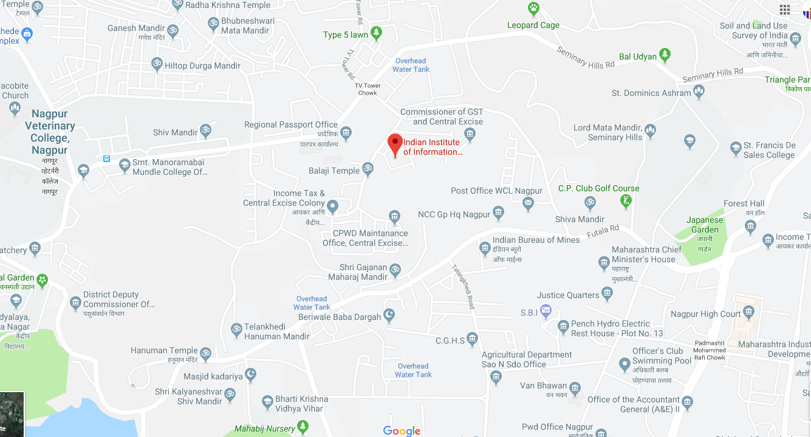
Contact us:
Mr. Harshad Panse
Sr. Office Associate T&P
Mobile: (+91) 92255 31185
Email: tnp@iiitn.ac.in / iiitntnp@gmail.com
Address:
Indian Institute of Information Technology Nagpur,
BSNL - Regional Telecom Training Center, Near TV Tower or Beside Balaji Temple, Seminary Hills, Nagpur, Maharashtra – 440006

