Slide 1
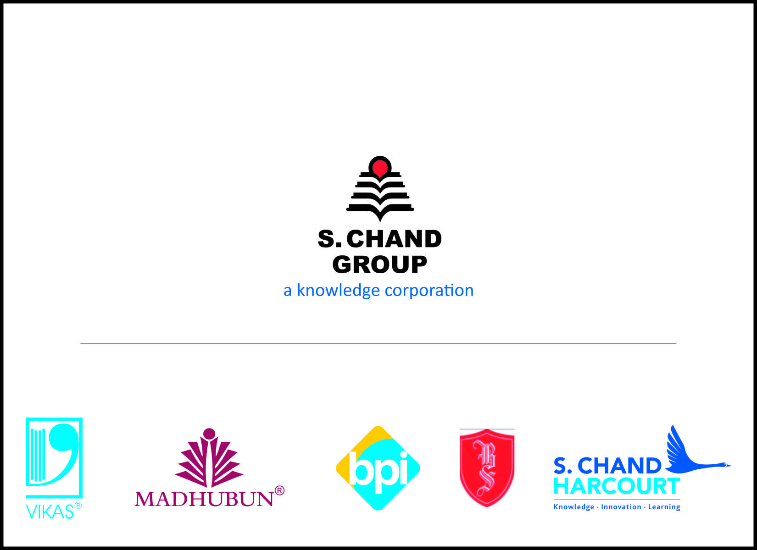


Slide 2
Group Companies
S. Chand Publication Pvt. Ltd.
S. Chand Harcourt (India) Pvt. Ltd
S. Chand Digital Pvt. Ltd.
S. Chand Eduech Pvt. Ltd.
S. Chand Technologies Pvt. Ltd.
S. Chand International (Exports Division0
Vikas Publication Pvt. Ltd.
Madhuban Publication
BPI India Pvt. Ltd.
Blackie & Sons
RRPL (Printing Division)
Eurasia Pvt. Ltd.
Shyam Lal Charitable Trust
Rise Kids – Pre School

Slide 3
a bit ABOUT us
Serving Nation for over 75 years in education sector, Group founded by Late Shri. Shyam Lal Gupta in 1939
Conferred with coveted Padam Shri in 1969 for his immense contribution to Indian Education & Publishing Industry.
Managed by 3rd generation entrepreneurs with professionals at guard of key functions.
With 2000+ team members across.

Slide 4
Dominant positioning amongst CBSE, ICSE schools., Engineering, Commerce & Basic Sciences.
Largest channel network in the country, catering to Schools. Engineering colleges, degree colleges. Strong network spread in India, SAARC Countries, the Middle East, Africa, Europe, and the America.
Over 9000 titles and >1000 authors
Largest player in the industry in education segment.
Own state of the art printing and publishing facilities.
Footprints across the nation with 50 branches, 60 marketing offices, state of the art printing & publishing facilities.

Slide 5
Education Segments – Group Presence
K - 12
Books for Kindergarten to Class 12 of the formal educational system (CBSE , ICSE & State Boards)
Higher Education & Distance Learning
Books for college students pursuing arts, science and commerce degrees, such as B.Sc., and B.Com including distance learning content
Technical
Books for technical/professional courses like engineering, medicine and law
Books for test preparation in competitive exams such as entrance exams, job selections and grade promotion
Competition

Slide 6
S. Chand Group
S. Chand Publishing
Vikas Publishing
Madhuban
BPI
S. Chand Harcourt
Shyamlal College
School Books (K-12)
Competition & Referral books (Test Prep)
Higher Education, Technical & Professional Education Books
Self Learning Products
Customized Content
Teacher Training & Leadership Training Practice
And many more……….
School Books (K-12)
Competition & Referral books (Test Prep)
Higher Education, Technical & Professional Education books
Customized Content
Best-sellers in competition, engineering, basic sciences & Commerce
And many more……….
School Books (K-12)
Teacher Training & Leadership Training Practice
K-12: ELT Grammar, Hindi,Science, Mathematics & GK.
And many more……….
Pre School Books
Children Books & Educational Toys
Self Learning Products
Business Books
General Books
And many more……….
Digital content & Interactive Classroom Solutions
And many more……….
Higher Education

Slide 7
our STRENGTHS
ONE STOP SOLUTION FOR EDUCATION CONTENT
Leading publisher of educational content
and digital solutions in India.
Over 7 decades of presence in India.
Established brands selling over 24 million books.
Largest channel network in the country.
2nd largest player in the customized content (for distance learning programs)

Slide 8
our VALUES
Safeguarding the interests of the Stakeholders
Valuing / Nurturing People
Transparent & Integrity
Ownership at all Levels
Sharing of best practices
Work-life balance

Slide 9
Philosophy behind Values
Aims at nurturing people at all levels by facilitating their growth
and needs as people are the greatest strength to any organisation.
Aims at being transparent in its vision, objectives, working and looks forward to honesty, integrity and commitment.
Expects and trains its people to take ownership of responsibilities entrusted. This applies to professional commitments, promoting the culture of the organisation and achieving organisational goals.

Slide 10
a look at the FUTURE
Acquisition in the segments
Management Books
Children & General Books
Medical, Taxation
Engineering & Medical Entrance
Vocational (polytechnics, pharmacy)
Regional Books in Higher Academic & Technical
Regional State Board School Books

Slide 11
Digital Business of S. Chand
The Company has Joint Venture with Houghton Miffin Harcourt with the objective to enter the digital market four years back.
Launch of S Chand “Intellitab” with Destination Success Interactive Content - channelized efforts towards availability of content which is platform agnostic across e-books, computers, tablets and mobile devices.
Digital Publishing Platform for e-books with revamped e-commerce platform
E-book distribution through Google, Amazon, Intel etc.
Assessment, Test-prep & Analytics on Web Platform with Third Party Aggregation.

Slide 12
AWARDS
Late Sh. Shyam Lal Gupta received Padma Shri in 1969.
The Company was the first recipient of the Bewst Publisher Award by the University Grants Commission.
Awarded with the Best Publisher Award from Central Board of Secondary Education.
In 2004, it received the Knowledge Pillar of India Honour Award organized by Vivekanand Education, Cultural & Games Organization, Deoghar Jharkhand,
Certificate of distinction for Best Stall Display award by the Federation of Indian Publishers in 2006 Book Fair
These are just a few from the huge list. These awards just inspire team to work harder for more success.

Slide 13
Corporate Social Responsibility
The group believes in giving back to the society in the best possible manner that it can. For this, the Company has funded the establishment of a world-class library at the American Institute of Indian Studies, Gurgaon, India.
Unlike others, we ensure that their thoughts are translated into reality and do not remain mere words on some vision statement papers an presentations.
Group is closely associated with NGO – Amar Jyoti, Delhi to support underprivileged & handicapped children who need support from the society.

Slide 14
Thank You

